Slide 1
ENHANCED ENTITY-RELATIONSHIP (EER) MODEL – 2
Dr. Ejaz Ahmed

Slide 2
Objectives
Insertion and Deletion Rules +
Hierarchies and Lattices +
S/G Conceptual Data Modeling +
Categorization +
Conceptual Object Modeling +
Higher Degree Relationships +
Dr. Ejaz Ahmed

Slide 3
- Insertion and Deletion Rules
Deleting an entity from a superclass implies that it is automatically deleted from all subclasses to which it belongs.
Inserting an entity into a superclass implies that the entity is mandatorily inserted in all predicate-defined (or attribute-defined) subclasses for which the entity satisfies the defining predicate.
Inserting an entity into a superclass of a total specialization implies that the entity is mandatorily inserted in at least one of the subclasses of the specialization
Dr. Ejaz Ahmed

Slide 4
- Hierarchies and Lattices
A subclass itself may have further subclasses on it, forming a hierarchy or a lattice of specialization.
In a hierarchy every subclass participates as a subclass in only one superclass/subclass relationship.
In a lattice a subclass may participate as subclass in more than one superclass/subclass relationship.
A subclass with more than one superclass is called a shared subclass.
A shared subclass inherits attributes and relationship from multiple superclasses, resulting in having multiple inheritance.
Dr. Ejaz Ahmed

Slide 5
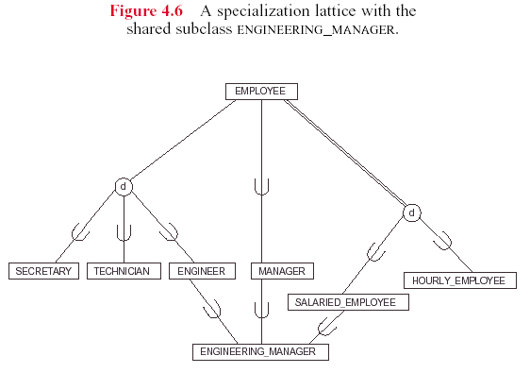
-- Example of a Lattice
Dr. Ejaz Ahmed
Notes:
Modify or enhance diagram Figure 4.6, Example of Lattice, slide 5
by adding
employee must be Manager if
nationality is Pakistani, job type is Engineer
dept. Admin and Full time employee only

Slide 6
- S/G Conceptual Data Modeling
In the specialization process, we typically start with an entity type and then define its subclasses by successive specialization. This process is top-down conceptual refinement process during the conceptual schema design.
The example show in the this figure of a university database shows this process. We start by the PERSON entity then we define its (overlapping) subclasses EMPLOYEE, ALUMNUS, STUDENT. We continue this process until we get all the subclasses shown in the figure.
Another method of reaching the same lattice is through a bottom-up conceptual synthesis process. We start by identifying the entity types that actually represent the subclasses. Then the generalization is used to collect the common attributes and relationships between subclasses to create the superclasses, and so on.
Dr. Ejaz Ahmed

Slide 7
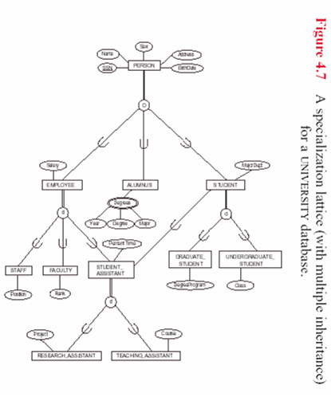
-- Example: Conceptual Modeling
Dr. Ejaz Ahmed

Slide 8
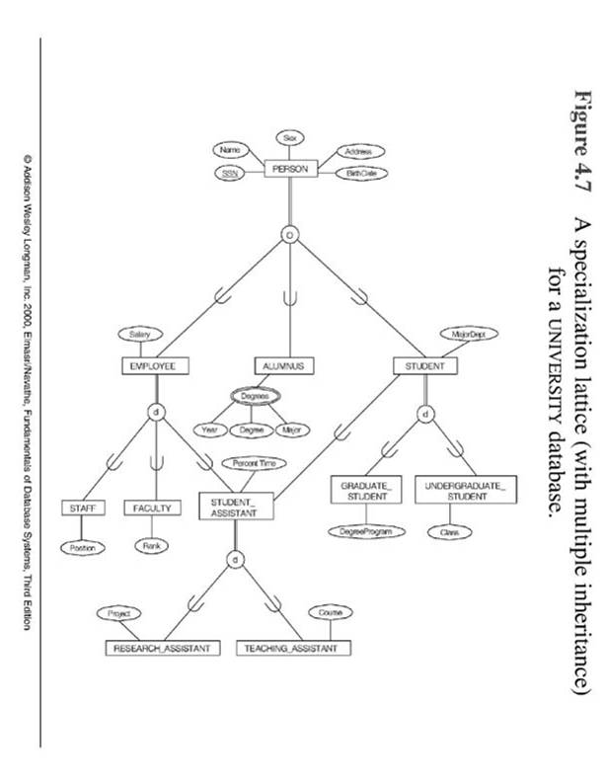
Dr. Ejaz Ahmed

Slide 9
- Categorization
Categorization (Union) is the modeling of a single subclass (called a category) with a relationship that involves more than one distinct superclasses. (see this Figure)
The difference between category and a shared subclass is that a shared subclass entity must be a member of all the superclass entities (intersection) whereas a category is a subset of the union of its superclasses. Hence an entity which is a member of a category must exist in only one of the superclasses.
In a category, subclass has selective inheritance.
Categories can be either total or partial.
  Total: every occurrence of all superclass must appear in the category.
  Partial: Some occurrences of all superclasses may not appear in the category.
Dr. Ejaz Ahmed

Slide 10
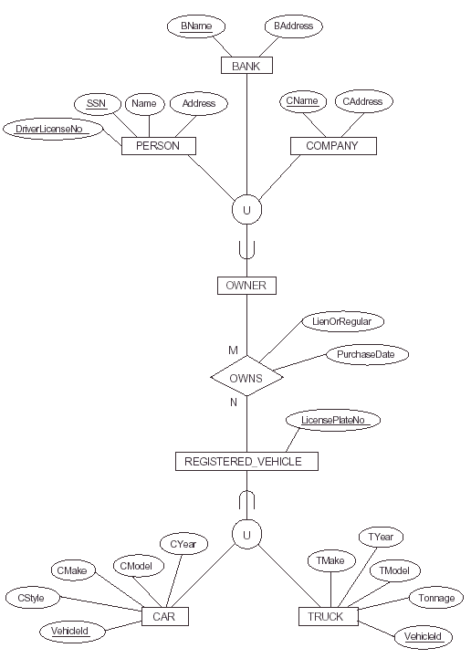
Dr. Ejaz Ahmed

Slide 11
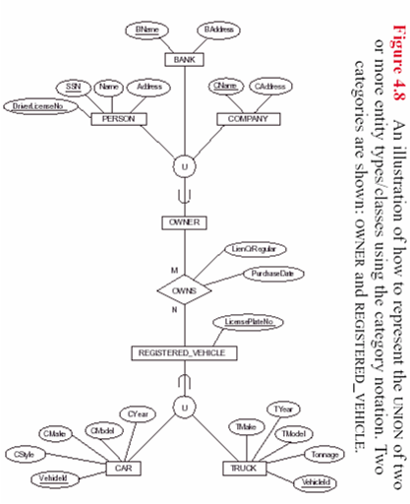
-- Example: Categorization
Dr. Ejaz Ahmed

Slide 12
- Conceptual Object Modeling
Object modeling methodology, such as UML (Universal Modeling Language) and OMT (Object Modeling Technique) are becoming increasingly popular.
Although these methodologies were developed mainly for software design, but they can be used in the database design.
The class diagrams of these methodologies are similar to the EER diagrams in many ways.
Dr. Ejaz Ahmed

Slide 13
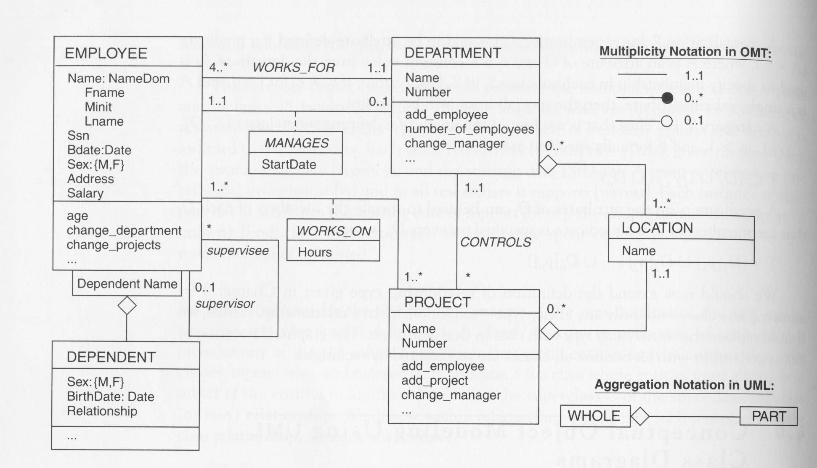
Dr. Ejaz Ahmed

